Slide 1



WELCOME!
FIN: 447808-1-52-01 and 443905-1-52-01
SR 90/US-41/SW 7 Street from east of 27 Avenue to Brickell Avenue
Design Roadway Project
The presentation will begin at 6:15 p.m.

Slide 2
Si usted necesita traducción durante la reunión por favor levante su mano o puede pedir ayuda de traducción a través del chat y un miembro de nuestro equipo lo asistirá.

Slide 3
Si w bezwen tradiksyon pandan reyinyon an tanpri leve men w oswa ou ka mande asistans tradiksyon atravè chat epi yon manm ekip nou an ap edew.

Slide 4
If you experience technical difficulties, contact Maria Alzate for assistance at (305) 560-8218 or maria@iscprgroup.com

Slide 5
We would like to recognize any federal, state, county, or city officials who may be present in person.​
​
If online, please select the Raise Hand feature
on the ​control panel.

Slide 6

General Information
Project
Non-Discrimination Policy
Rules of Engagement
Meet the Project Team
Location
Benefits
Information and Scope of Work
Schedule and Cost
What to Expect During Construction
AGENDA
Q&A Session
Open discussion
Contact information

Slide 7
The Florida Department of Transportation is required to comply with various non-discrimination laws and regulations, including Title VI of the Civil Rights Act of 1964.
Public participation at this meeting is solicited without regard to race, color, national origin, age, sex, religion, disability, or family status. Persons wishing to express their concerns about Title VI may do so by contacting:
District Six Title VI Coordinator
Mark Plass at 305-470-5219 or in writing:
FDOT, 1000 NW 111 Avenue,
Miami, FL 33172, email: Mark.Plass@dot.state.fl.us
State Title VI Coordinator
Stefan Kulakowski at 850-414-4702 or in writing:
Equal Opportunity Office
605 Suwannee Street, MS 65,
Tallahassee, FL 32399 email: Stefan.Kulakowski@dot.state.fl.us
NON-DISCRIMINATION POLICY

Slide 8
This meeting is being recorded.
The meeting will begin with a presentation followed by comments and questions.
If you are calling in via phone, you will not be able to provide comments during the meeting. To provide comments, call (305) 560-8218 or e-mail maria@iscprgroup.com.
Tonight’s presentation is available at:
https://www.fdotmiamidade.com/design-projects/south-miami-dade/sr-90us-41sw-7-st-from-east-of-sw-27-ave-to-brickell-ave.html
RULES OF ENGAGEMENT

Slide 9
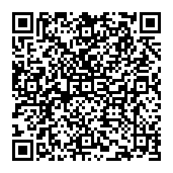
Scan the QR code to
download the presentation
RULES OF ENGAGEMENT

Slide 10
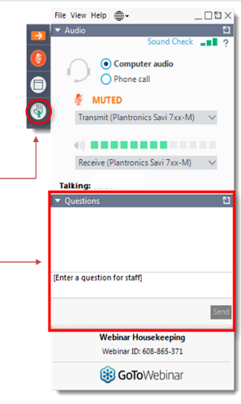
During the Open Discussion, in-person attendees will be called on first. A staff member will advise when to state your question.
Virtual attendees will remain muted except for the Open Discussion session. To participate:
    Use the “Raise Hand” button on your GoToWebinar panel and you will be unmuted.
    Submit comments or questions via the “Question” box.
  All attendees will have three minutes to participate.
RULES OF ENGAGEMENT

Slide 11
MEET THE PROJECT TEAM
FDOT
Project Manager
Consultant
Project Manager for FM 447808-1
Mario Duran, P.E.
Mehrdad Ebrahimi, P.E.
Consultant
Project Manager for
FM 443905-1
Jeannelia Liu, P.E.
Community
Outreach Specialist
  Jose Ignacio Grados

Slide 12

FDOT COMPASS
The Florida Department of Transportation (FDOT) is committed to ensuring that the state’s infrastructure will efficiently serve residents and visitors, now and in the future, with an emphasis on embracing the communities we serve to achieve their vision and meet their transportation needs.
The Department focuses on key areas to achieve that, including safety, resiliency, supply chain, technology, and workforce development. Each of these elements touches the lives of the people who use our roadways.
FDOT understands the community’s unique needs and builds a transportation system that improves connectivity, enhances the quality of life, and achieves a shared community vision.

Slide 13
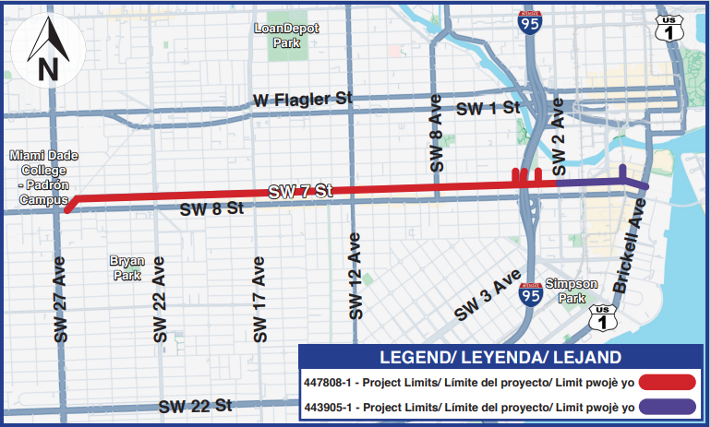
447808-1 and 443905-1: SR 90/US-41/SW 7 Street from east of 27 Avenue to Brickell Avenue
PROJECT LOCATION MAP AND PURPOSE
The primary purpose of this RRR (Resurfacing, Restoration and Rehabilitation) project is to preserve and extend the life of the pavement, as well as enhance roadway safety.

Slide 14






Providing a midblock crossing on SW 7 Street between SW 18 Avenue and SW 19 Avenue
Installing new crosswalks at several intersections
Enhancing signalization at several intersections
Upgrading roadway and pedestrian signage, curb ramps and lighting at several intersections
Closing SW 4 Avenue at SW 7 Street
Repaving and restriping the road
PROJECT SCOPE
Widening the I-95 southbound (SB) off-ramp at SW 7 Street to four lanes
Closing SW 4 Avenue will improve the operation at the intersection
Upgrading lighting
This project creates opportunities for contractors resulting in economic benefits for workers and the community

Slide 15
RESURFACING, REHABILITATION AND RESTORATION
OF SW 7 STREET CORRIDOR
WEST OF SW 2 AVE
EAST OF SW 2 AVE
Improving Signalization at NINE intersections that are currently signalized either by replacing or adding new features.
Implementing full signalization by installing new features at FIVE intersections not currently or only partially signalized.
Pavement restoration through repaving and restriping
ADA improvements
Upgrading pedestrian signalization features
Installing crosswalks at Beacom Blvd, SW 13 Avenue, SW 5 Avenue, 1 Ct, and NB South Miami Ave

Slide 16
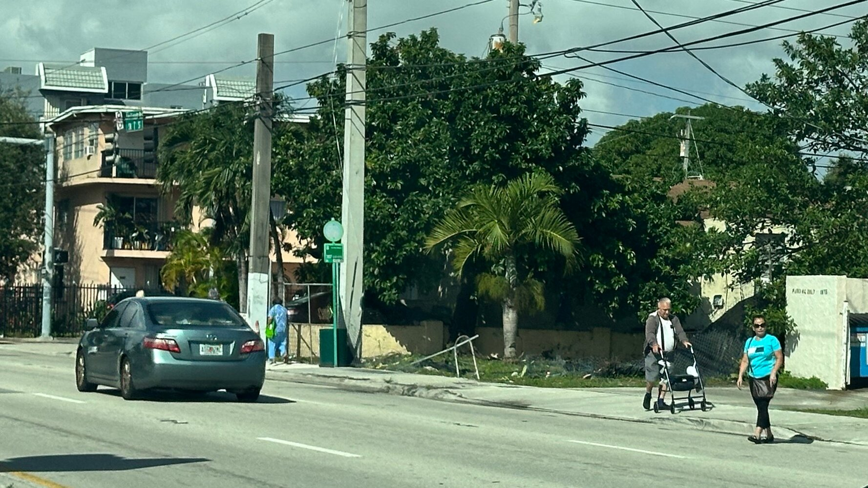
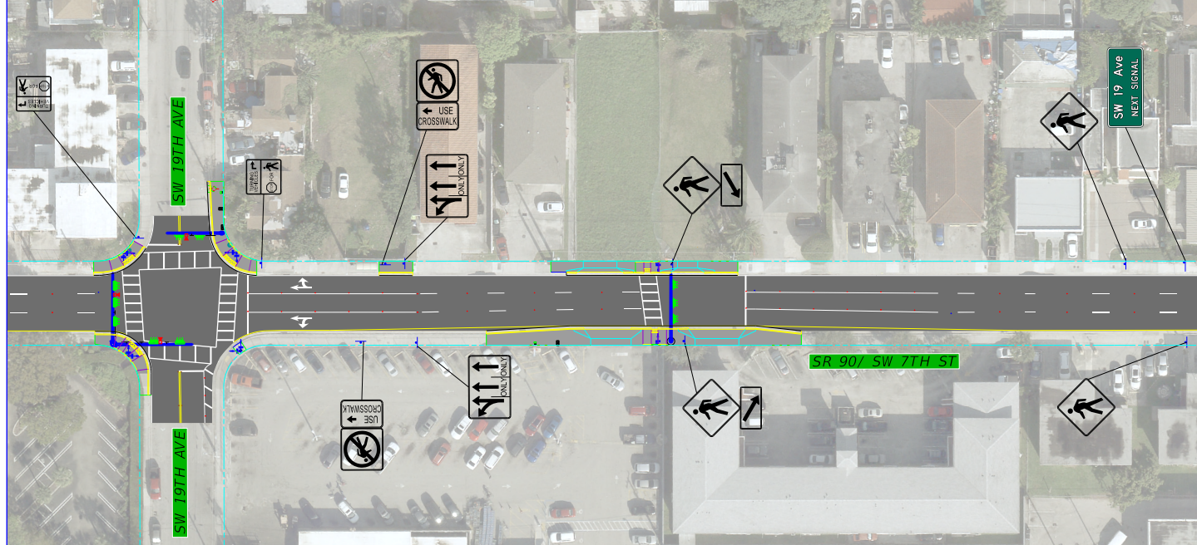
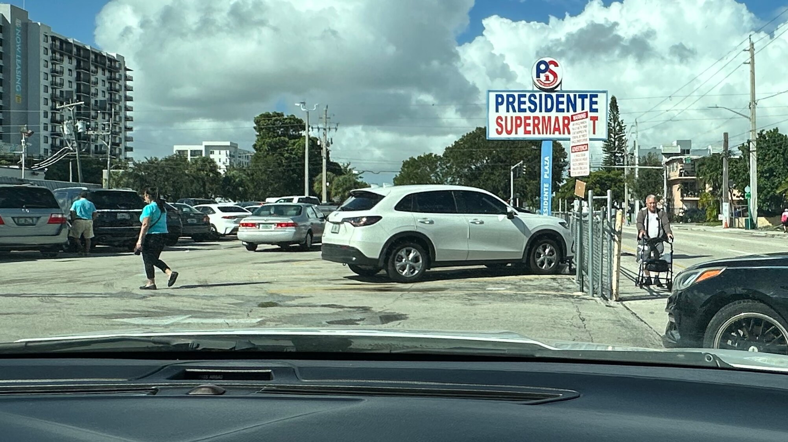
MIDBLOCK CROSSING BETWEEN SW 18 AVENUE AND SW 19 AVENUE
Existing Condition
PRESIDENTE SUPERMARKET
Existing Condition
Installing a signalized midblock crossing between SW 18 Avenue and SW 19 Avenue

Slide 17
IMPROVEMENTS AT I-95 SB OFF-RAMP, SW 4 AVENUE AND SW 3 AVENUE
PUBLIX
Closing SW 4 Avenue at SW 7 Street
Widening I-95 SB off-ramp to four lanes
Widening SW 3 Avenue to convert from a one-way, two-lane to a two-way, three-lane between SW 6 Street and SW 7 Street
Converting SW 4 Avenue into a two-lane, two-way from SW 7 Street to SW 6 Street
Providing new traffic signals at the intersection of SW 4 Avenue and SW 6 Street
Providing new traffic signals at the intersection of 3 Avenue and SW 6 Street

Slide 18
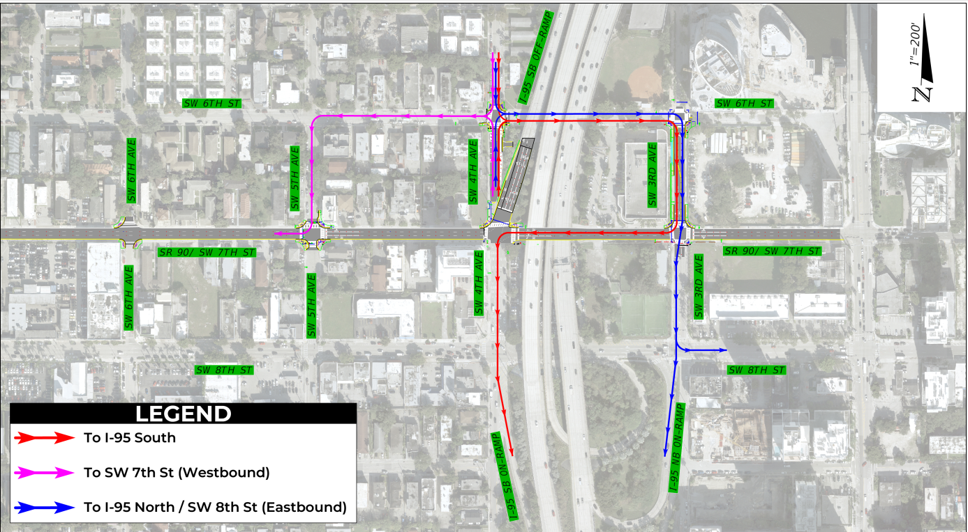
NEW TRAFFIC FLOW AFTER CLOSURE OF SW 4 AVENUE

Slide 19
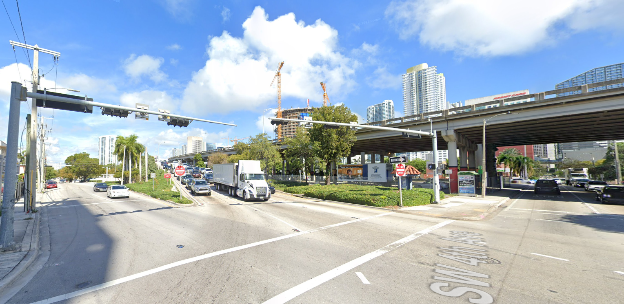
EXISTING CONDITIONS AT SW 4 AVENUE

Slide 20
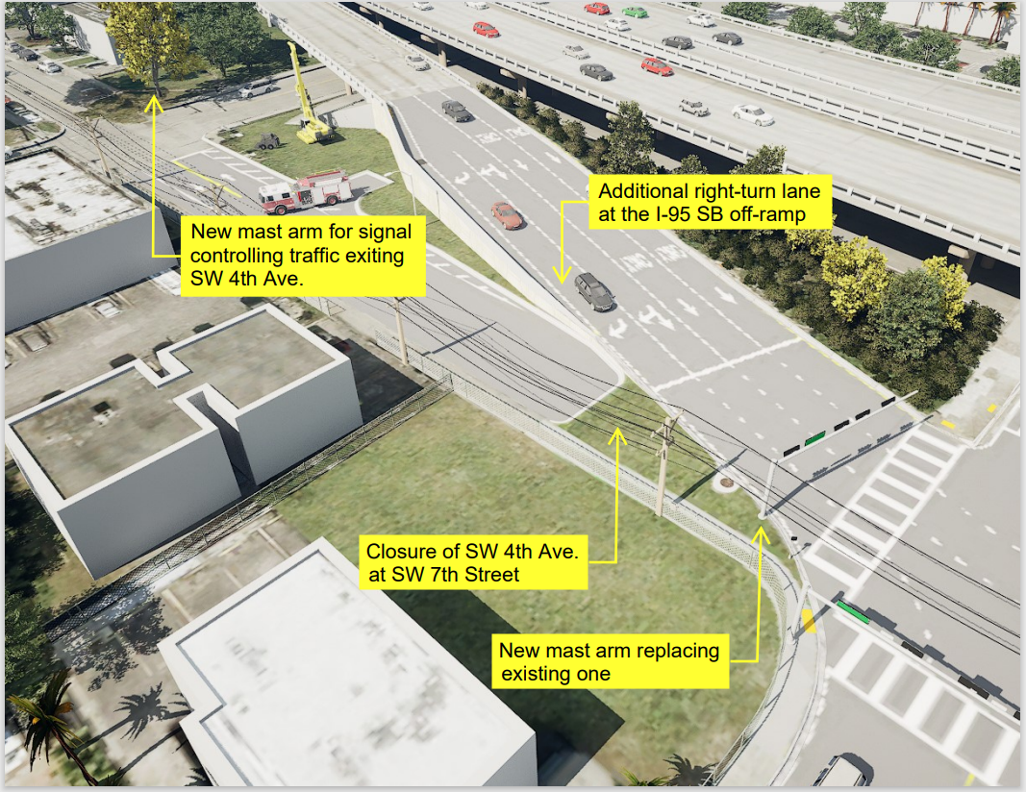
PROPOSED CLOSURE OF SW 4 AVENUE AND
WIDENING OF SB I-95 OFF-RAMP
Intersection of SW 4 Avenue and SW 7 Street registers:
  Number of accidents above state average
  Source: FDOT Traffic Operations, Safety Study (2024)

Slide 21
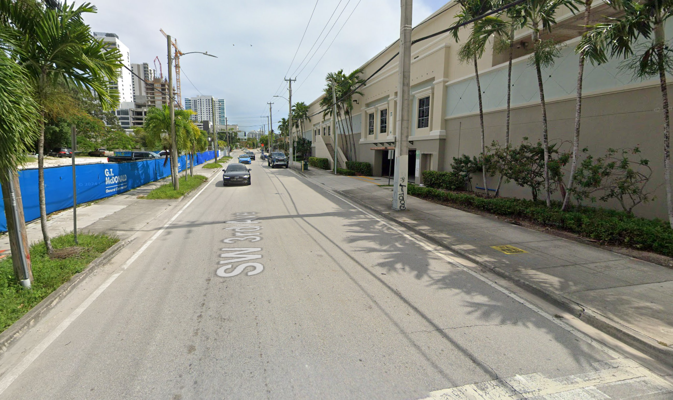
EXISTING CONDITIONS AT SW 3 AVENUE

Slide 22
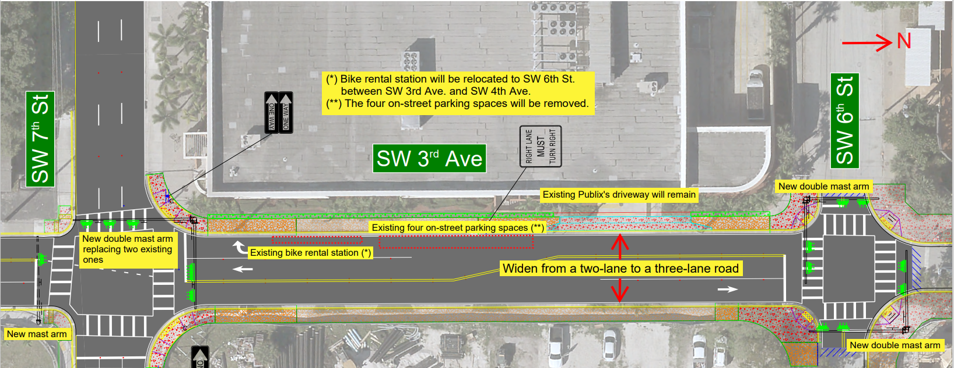
PROPOSED WIDENING OF SW 3 AVENUE
Widening SW 3 Avenue between SW 6 Street and SW 7 Street and converting the traffic pattern from one-way northbound to three-lane, two-way traffic.

Slide 23
443905-1: SAFETY IMPROVEMENTS AT SW 2 AVENUE AND SW 1 COURT
SW 2 Avenue
The existing raised median will be extended.
SW 1 Court
The intersection will be fully signalized and bulb outs will be created at the NW and SW corners.

Slide 24
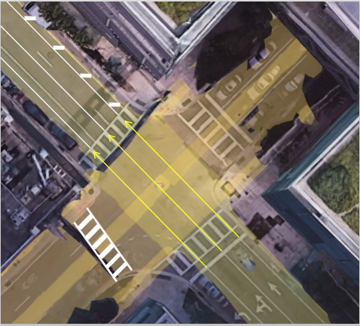
443905-1: SAFETY IMPROVEMENTS
NB SOUTH MIAMI AVENUE AND BRICKELL AVENUE
NB South Miami Avenue
Realigning pavement markings and adding new crosswalk.
Brickell Avenue
A pedestrian refuge will be provided at the south side by extending the median nose.

Slide 25
Milestone | Date
Design Completion | October 2025*
Contracting Date | June 2026*
Construction start | October 2026*
Construction duration | 14 months*
Construction end | December 2027*
Current Construction cost | $14.3 Million*
PROJECT SCHEDULE AND COST
Schedule and cost subject to change
The project is currently in the design phase.
Work with municipalities to review plans
Receive feedback from the public

Slide 26
COMMUNITY OUTREACH EFFORTS
Swire Props LLC
City of Miami Dept. of Public Works
Development at SW 3 Ave
Commissioner Eileen Higgins (District 5)
Door to Door and Meeting with owner of SW 4 Avenue property
Design team met with representatives for impacted property –
May 2023
Design Team met with City of Miami Dept. of Public Works and advised on the project–
November 2022 and 2023
Design Team met with Development representatives regarding SW 3 Avenue widening –
November 2023
Design team met with County commissioner’s office –
October 2024
Design Team completed a door to door along SW 4 Avenue –
November 2024

Slide 27
Construction activities will be completed in phases to minimize impacts to the public.
Maintenance of Traffic (MOT):
  Lane closures shall occur during non-peak hours on non-event days, nights and weekends.
  At least one travel lane will remain open.
  Pedestrian detours will be clearly marked.
Non-peak hours are:
  447808-1-52-01
  5 a.m. to 3:00 p.m. Weekdays
  9 a.m. to 7 p.m. Weekends
  443905-1-52-01
  9 a.m. to 3:30 p.m. Weekdays
  8 p.m. to 6:30 a.m. Weekdays and Weekends
WHAT TO EXPECT DURING CONSTRUCTION

Slide 28


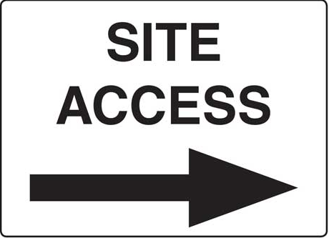
Posted Speed:
  Existing 30 Mile Per Hour (MPH) limit will remain.
Dust:
  The contractor will be required to water and sweep in order to minimize construction-related dust.
WHAT TO EXPECT DURING CONSTRUCTION
Noise:
  Some noise should be expected during allowable construction hours.
Access:
  Access to businesses and residences will be maintained.

Slide 29
In-person attendees, please form a line to participate.
Virtual attendees:
  Submit your comments in the “Questions” box
  If you wish to speak, please use the “Raise Hand” button on your GoToWebinar panel, and you will be unmuted.
All participants will have three minutes to provide comments​/questions. Please clearly state your name and address.
Staff will be available to answer questions in the order they are received and as time permits. If your question is unanswered during the event, a response will be provided in writing afterward.
OPEN DISCUSSION

Slide 30
CONTACT
Community Outreach Specialist
Jose Ignacio Grados
305-470-5477
Josei.Grados@dot.state.fl.us
www.southflroads.com
Download tonight’s presentation at:
https://www.fdotmiamidade.com/design-projects/south-miami-dade/sr-90us-41sw-7-st-from-east-of-sw-27-ave-to-brickell-ave.html
Please take our exit survey!
CONTACT INFORMATION

Slide 31
Scan the QR code to
download the presentation
CONTACT INFORMATION

Slide 32


